Slide 1
CSE 12: PA5
2-4-21
Focus: PA5, Quick Sort Partition

Slide 2
PA5 Overview
PA5 is a closed assignment!
You will be implementing 3 methods in PartitionOracle.java
findCounterExample
generateInput
isValidPartitionResult
Writing your own tests in TestPartitionOracle.java
Writing 3 different Partitioners
RandomPivotPartitioner.java
FirstElePivotPartitioner.java
CentralPivotPartitioner.java
Tips:
The autograder on Gradescope is very slow, so test locally. Do not use Gradescope as a debugger!

Slide 3
Quicksort

Slide 4
Quicksort Summary
Pick a pivot
This can be the first element, last element, middle element etc. (Needs to be consistent though)
Partition around the pivot
Repeat with the subarrays determined by the pivot

Slide 5
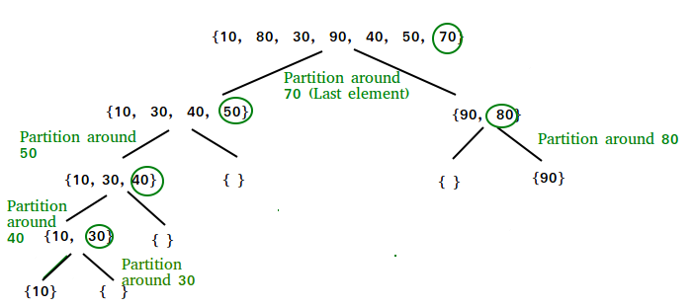
Graphic visualization of quicksort
Resultant single-element arrays to combine: {{10}, {30}, {40}, {50}, {70}, {80}, {90}}

Slide 6
Quicksort Partition

Slide 7
What is a partition in quicksort?
Partitioning is a component in quicksort and an algorithm that is called again and again until the original array elements are sorted as single-element arrays
A pivot index is selected (for example, pick the last element), then the array is partitioned in such a way that the input array has its elements moved around so that element values less than or equal to the pivot index’s value are to the left of the pivot index and element values greater than or equal to the pivot index’s value are to the right
Note: the array is not necessarily completely sorted here (and probably isn’t)!
Now the array is divided into two at the point where the pivot index ended up
Partition is called on each of these two subarrays using the “same” pivot point location (we picked the last element and do so again for each of these subarrays)
We partition again, and this process is repeated until we have single-element arrays that are sorted between themselves

Slide 8
How can we test any partition?
Direct unit testing is not always possible. For example, if we step through our own partition algorithm, we know what exact array it should output, and we can use assertArrayEquals to compare the returned array and what we expect. But, different partitioners could return different arrays that are still valid partitions! In this case, we want to test for a valid partition by testing whether or not the array produced matches with our general constraints: all elements from before are still present, the array length hasn’t changed, all elements to the left of the pivot index are less than or equal to the pivot value, and all elements to the right of the pivot index are greater than or equal to the pivot value

